Slide 1



A Machine Learning Approach for Brachial Plexus identification
Neha Sure
Deepika Velanati
Aishwarya Matam

Slide 2

AGENDA
Introduction
Understanding the Brachial Plexus
The Importance of Identification
Limitations of General Anesthesia
Benefits of Regional Anesthesia
Conferences

Slide 3
Introduction
Surgery often causes pain, which is managed with pain killers that have side effects.
Pain management catheters can reduce narcotics use and speed recovery.
The goal is to build an approach to identify nerve structures of neck in ultrasound images for improving catheter placement.

Slide 4
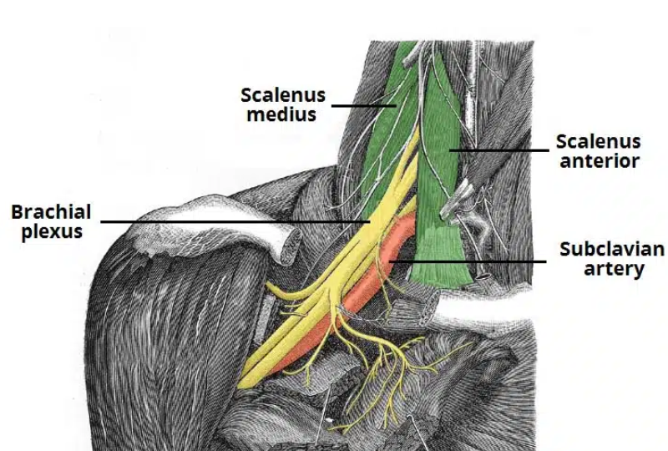
Understanding the Brachial Plexus
A network of nerves originating from the neck, extending to the shoulder and arm.
Connects the spinal cord to the arms and hands, enabling movement and sensation.
Essential for motor functions like shoulder movement, arm rotation, and hand control.

Slide 5
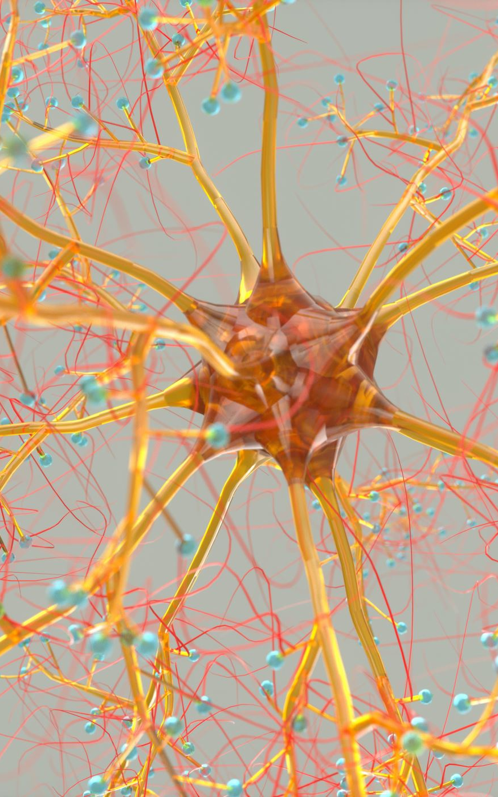
The Importance of Identifying
Detect injuries or damage
Identify congenital abnormalities
Guide surgeries to avoid nerve harm
Assess nerve functionality
Detect tumors or inflammation affecting the nerve.

Slide 6

Limitations of General Anesthesia
Risk of complications.
Longer recovery time.
Potential impact on vital organs.
Nausea and vomiting.

Slide 7
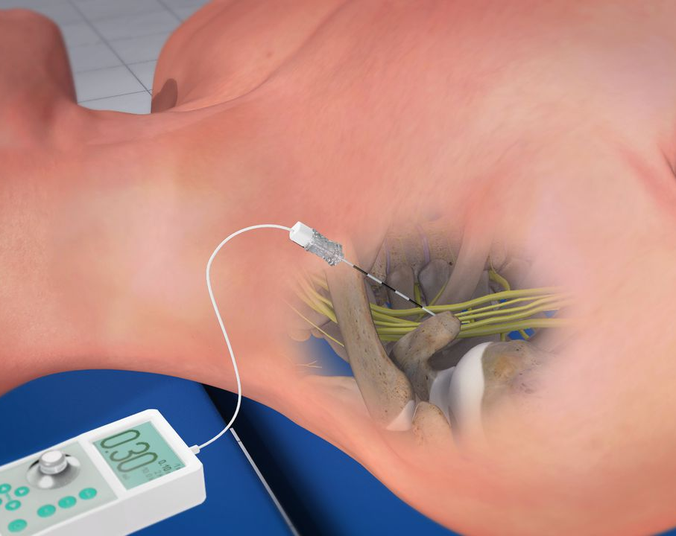
Benefits of Regional Anesthesia
Minimal systemic effects.
Faster recovery.
Less postoperative nausea.
Effective pain control.
Targets specific areas.

Slide 8
Conferences
2024 Conference on Artificial Intelligence, Machine Learning, and Business Analytics
Submission Deadline: October 10
ISCMI 2024
Submission Deadline: October 05

Slide 9
THANK YOU ANY QUESTIONS?

